Slide 1
Welcome to ELA 1

Slide 2
My name is Mr. Harshman

Slide 3
Take a moment and read over the syllabus.

Slide 4
Now, a little bit about myself…

Slide 5
This is my first year here at Hazelwood East.

Slide 6
Previously, I taught for 13 years at Gateway STEM High School in St. Louis Public Schools.

Slide 7
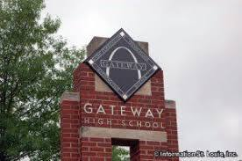

Slide 8
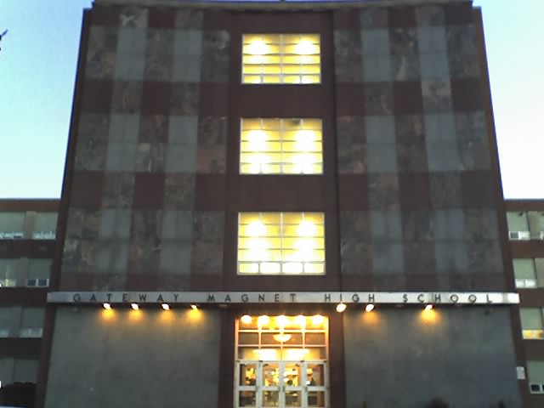

Slide 9
There I taught American Literature (Junior Lit.) for 5 years.

Slide 10
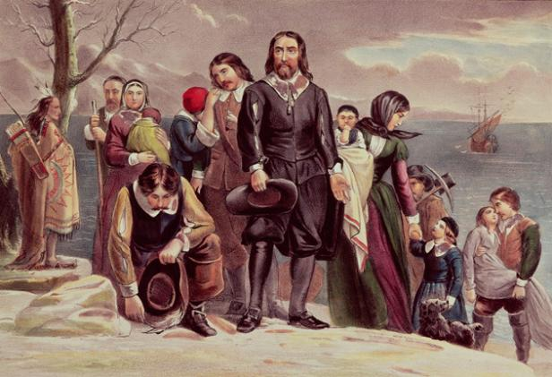
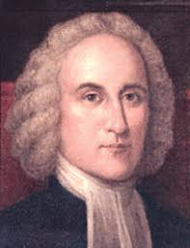
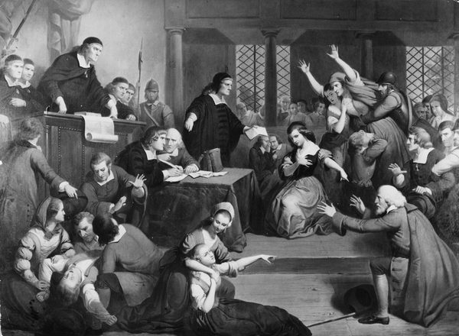

Slide 11
I also taught senior AP Literature for 3 years.

Slide 12
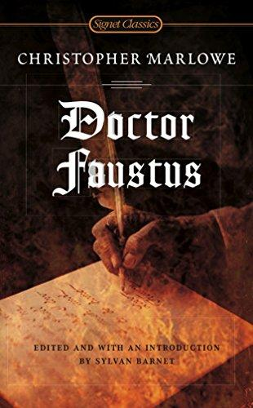
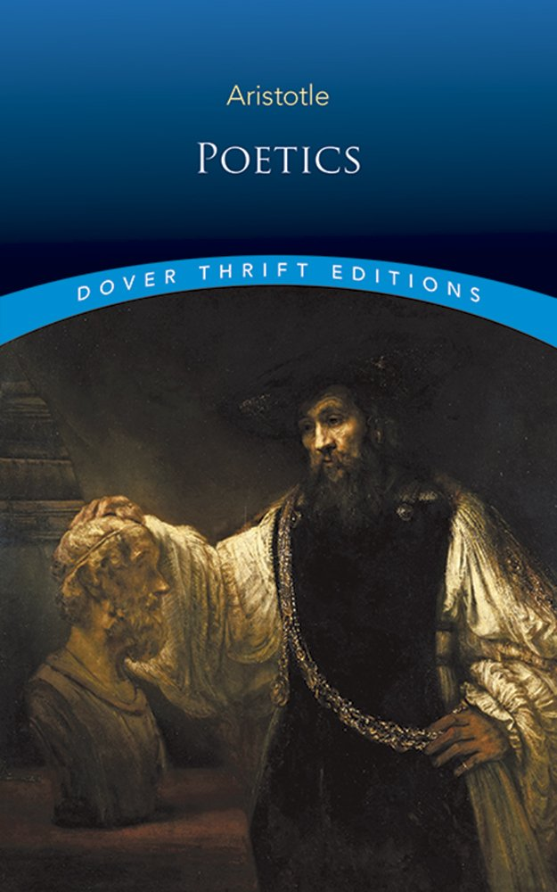
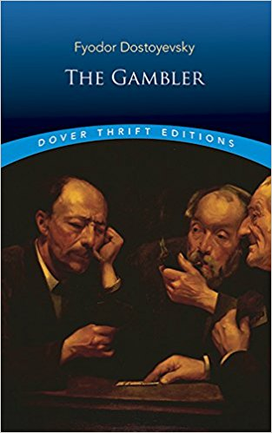

Slide 13
And for the last 10 years I have taught English and Composition at the college level (at St. Louis Community College – Meramec).

Slide 14
There I teach every facet of composition, from the remedial classes (English 020 & 030) to the regular and advanced classes (English 101 and 102).

Slide 15
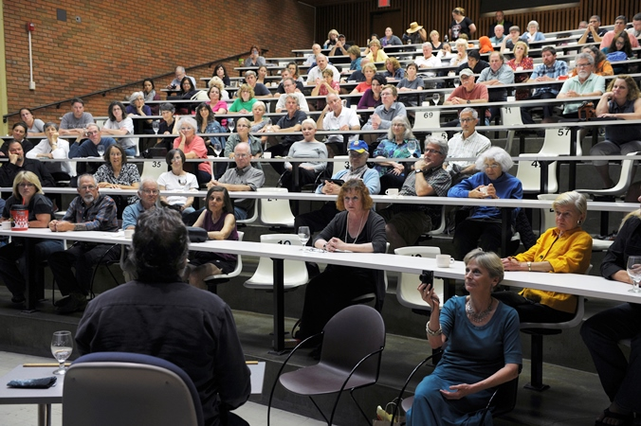

Slide 16
At Meramec I have enjoyed great success and fulfillment in helping students become better writers.

Slide 17
Not to brag, but I have a perfect score on Rate My Professor.com, a website that was designed so that students could complain about their professors.

Slide 18
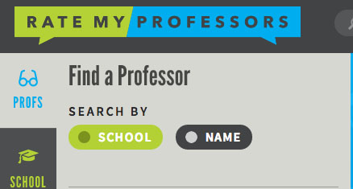

Slide 19
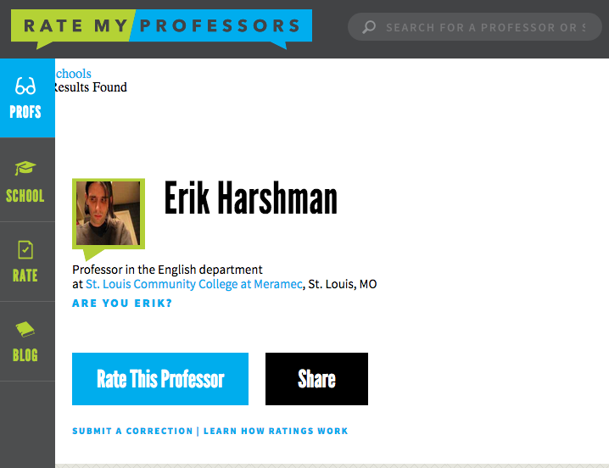

Slide 20
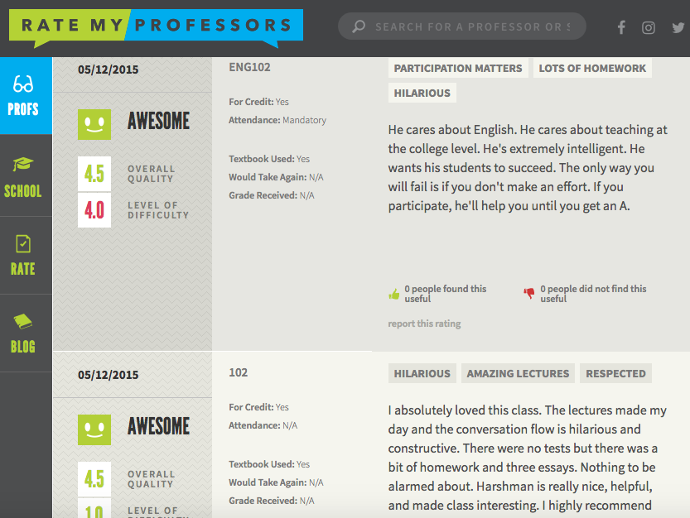

Slide 21
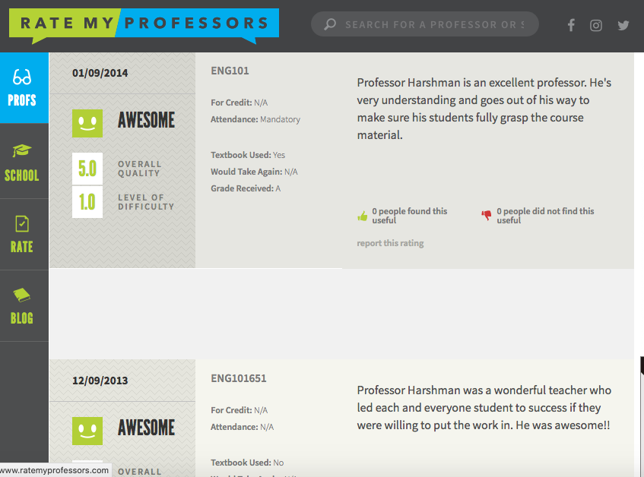

Slide 22
I have a Bachelors of Arts (BA) in Creative Writing with a minor in Film from the Santa Fe University of Art and Design in New Mexico.

Slide 23
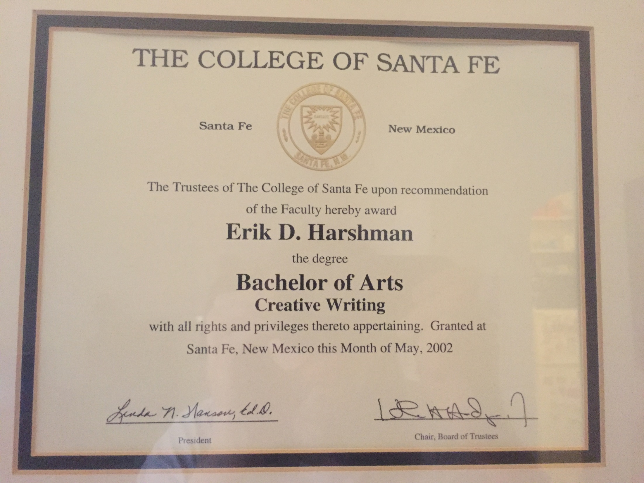

Slide 25
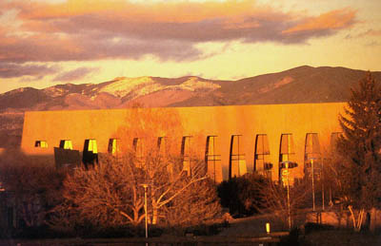
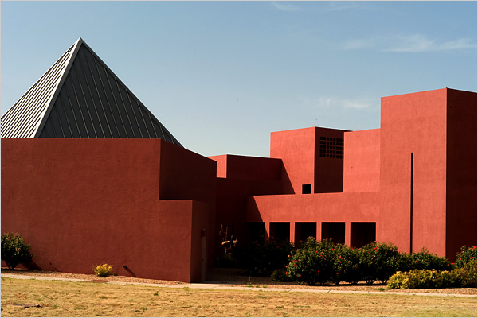
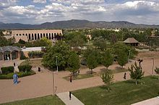

Slide 26
I also hold a Masters in the Art of Teaching (MAT) with emphasis in English from Webster University.

Slide 27
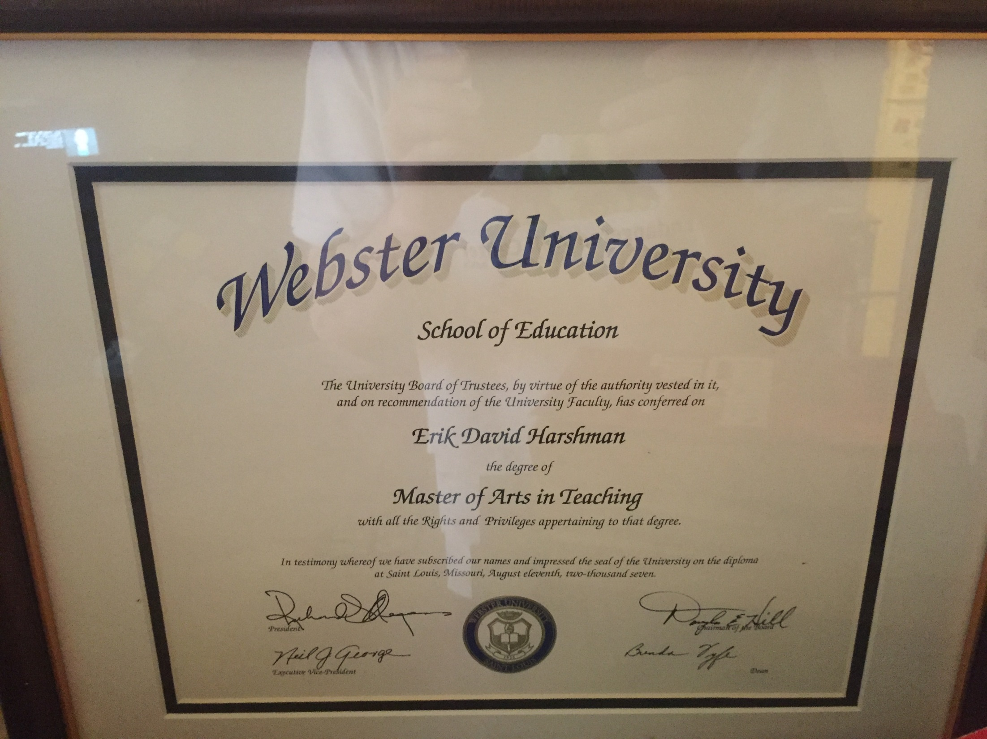

Slide 28
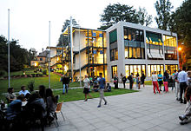
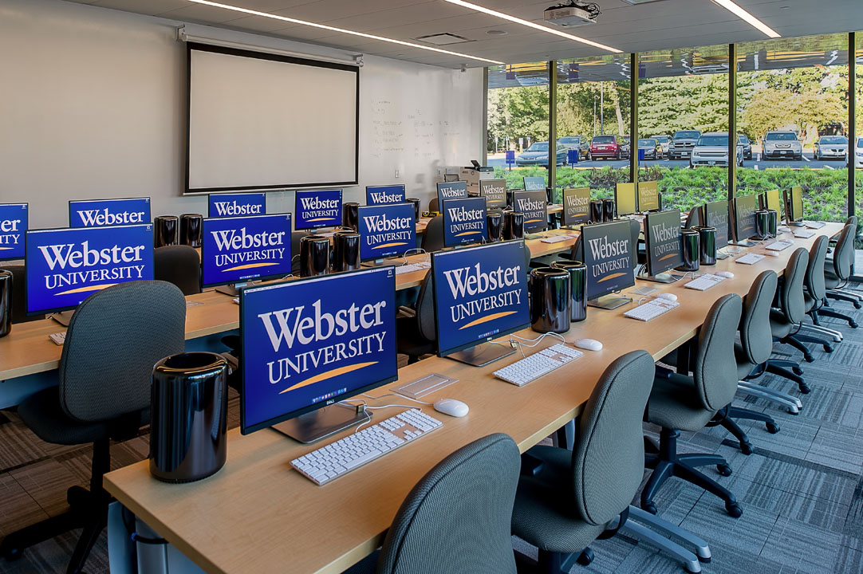

Slide 29
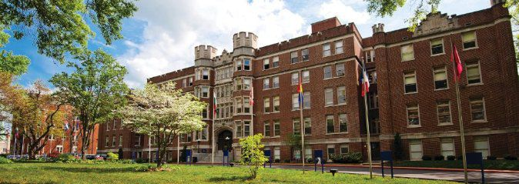
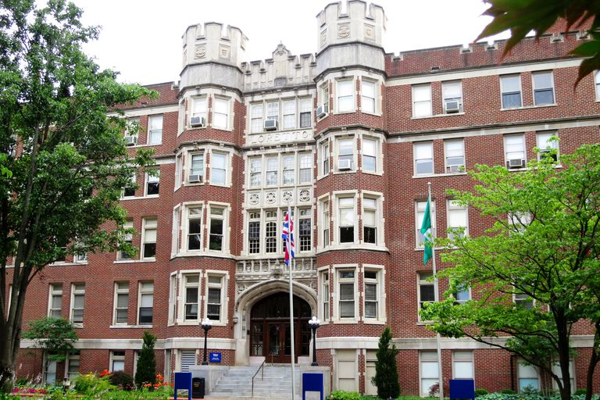

Slide 30
And, currently, I am working on my second Masters (this time a Master of Arts (MA) in English) at UMSL.

Slide 31
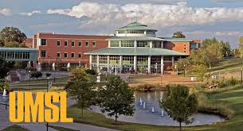
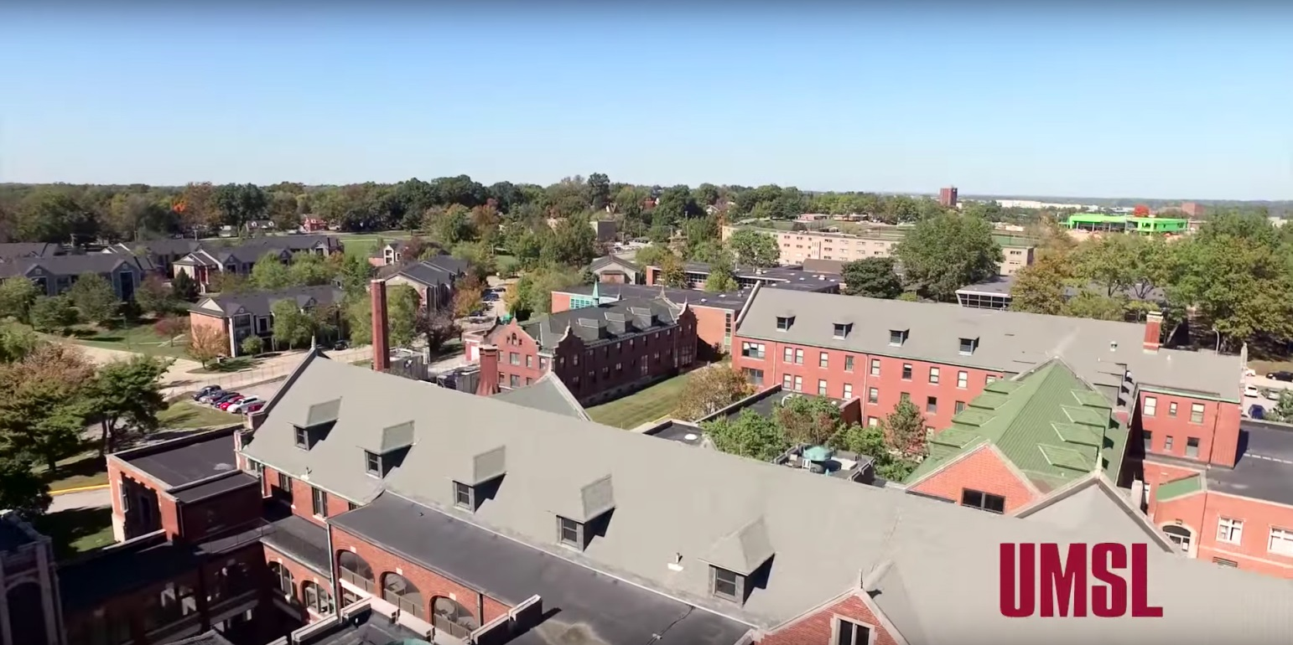

Slide 32
Additionally, as it can be assumed from my undergraduate major, I am a writer. I have two books that are in bookstores worldwide.

Slide 33
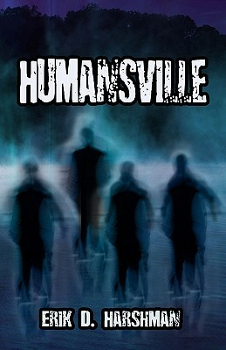

Slide 34
I have also self-published some of my other novels and have had my short fiction published in a variety of magazines (both print and digital).

Slide 35
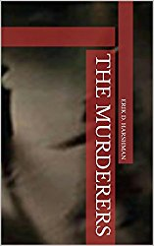
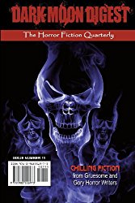

Slide 36
In total I have written 6 novels and 16 screenplays (movie scripts).

Slide 37
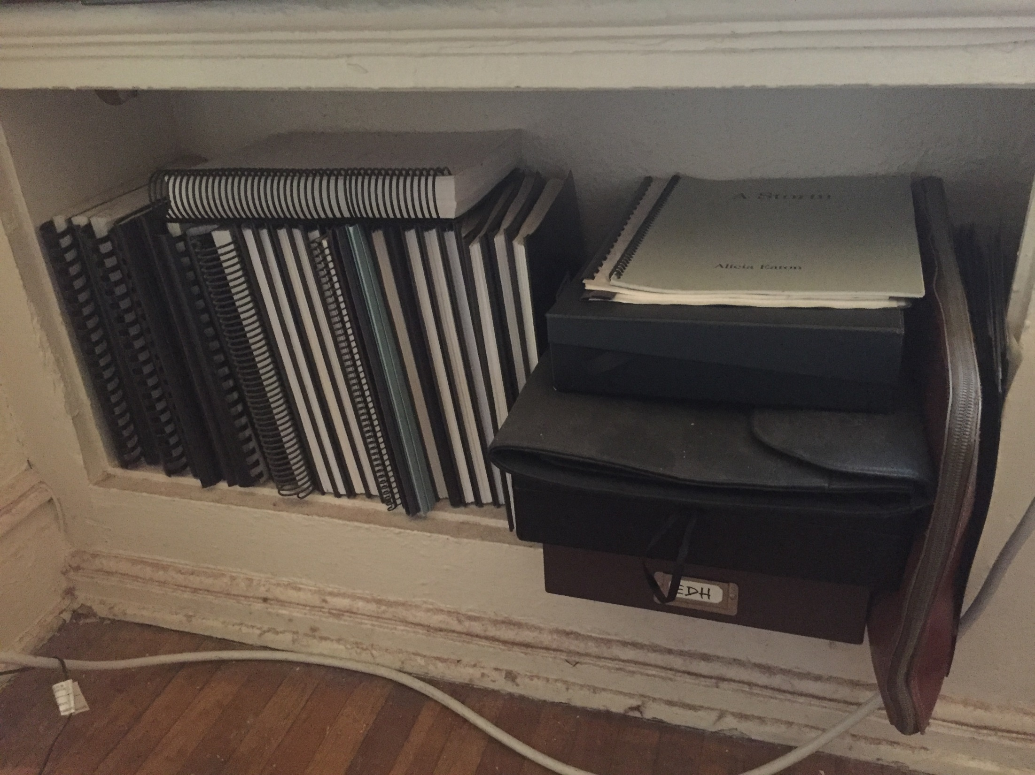

Slide 38
This school year…

Slide 39
First off, I am honored and humble to be teaching in the Hazelwood School District. This has been a dream of mine for a very long time.

Slide 40
I am confident that, in no time at all, you all will prove to me why I was so excited to come to this district and teach its amazing students.

Slide 41
We all know this school year is going to be different and challenging, but we will get through these challenges together.

Slide 42
If you need anything or are having trouble with anything relating to the material (curriculum) or the process (virtual learning) please reach out and I will do my best to assist you.

